Slide 1
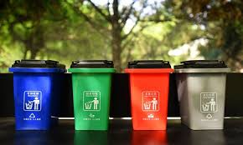

Garbage Classification
Using MachineLearning
(Convolution Neural Networks)
Smart Bridge-Remote Summer Internship Program

Slide 2
TEAM-20
SRIMINNU SURA 17UK1A05H8
SRILEKHA GADE 17UK1A05E7
DHARANI DAMERAGIDDA 17UK1A05F7
PERUGU MOHAN 17UK1A05J4
Under the guidance of ILANNA
TECH ARMY

Slide 3
ABSTRACT
Image segmentation and classification is more and more being of interest for computer vision and machine learning researchers. Many systems on the rise need accurate and efficient segmentation and recognition mechanisms. This demand coincides with the increase of computational capabilities of modern computer architectures and more effective algorithms for image recognition. The use of convolutional neural networks for the image classification and recognition allows building systems that enable automation in many industries. This article presents a system for classifying plastic waste, using convolutional neural networks. The problem of segregation of renewable waste is a big challenge for many countries around the world.
Apart from segregating waste using human hands, there are several methods for automatic segregation. The article proposes a system for classifying waste with the following classes: polyethylene terephthalate, high-density polyethylene, polypropylene and polystyrene. obtained results show that automatic waste classification, using image processing and artificial intelligence methods, allows building effective systems that operate in the real world.

Slide 4
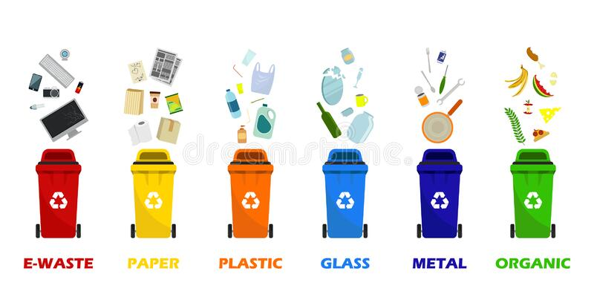
INTRODUCTION
There is a need today for an effective waste management since inaccurate waste disposal is a huge threat to the health of people and also to the environment. These effects can cause diseases to spread because of rodents,insects,and other pests that can cause gastrointestinal problems.
Waste is anything that is unusable and unwanted.There is a great need for human to understand the types and how they can manage this waste properly
Effective segregation of wastes means that less waste goes to landfill which makes it cheaper and better for people and the environment.
It is also important to segregate for public health.
Therefore, it is very important to have a better knowledge about the waste classification.

Slide 5
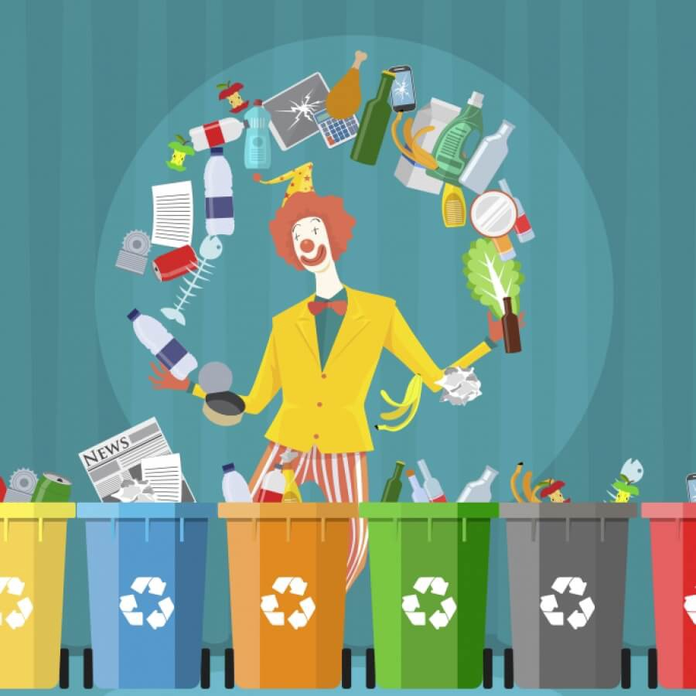
PROBLEM
The accumulation of solid waste in the urban area is becoming a great concern, and it would result in environmental pollution and may be hazardous to human health if it is not properly managed. It is important to have an advanced/intelligent waste management system to manage a variety of waste materials.

Slide 6
SOLUTION
The present way of separating waste/garbage is the hand-picking method, whereby someone is employed to separate out the different objects/materials. The person, who separate waste, is prone to diseases due to the harmful substances in the garbage. With this in mind, it motivated us to develop an automated system which is able to sort the waste and this system can take short time to sort the waste, and it will be more accurate in sorting than the manual way. With the system in place, the beneficial separated waste can still be recycled and converted to energy and fuel for the growth of the economy. The system that is developed for the separation of the accumulated waste is based on the combination of Convolutional Neural Network with recognition and classification.
Convolutional Neural Networks

Slide 7

CONVOLUTION NEURAL NETWORKS
In Deep Learning ,a convolution neural network is a class of deep neural networks which has become in various tasks. It is mostly commonly applied to analyse the visual images.
CNN’s are regularized version of multilayer perceptrons.Multilayer perceptron's usually mean fully connected networks, that is each neuron in one layer is connected to all neurons in the next layer. Convolution networks were inspired by biological processes.

Slide 8
APPLICATIONS OF CNN
Image recognition
Facial recognition
Image Net Large Scale Visual Recognition
Video recognition
Medical image analysis
Recommended system

Slide 9
SYSTEM DESIGNING
Jupyter Notebook Environment
Spyder Ide
Machine Learning Algorithms
Python
Flask
We have developed this Garbage classification model by using the Python language which is a interpreted and high level programming language and using the Machine Learning algorithms for coding we used Jupyter Notebook environment of the Anaconda distributions and the Spyder, it is an integrated programming in the Python language.
For creating an user interface for the prediction we used the Flask. It is a micro web framework written Python. It is classified as Microframework because it does not require particular tools or libraries. It has no database abstraction layer, form validation, or any other components where pre existing third-party. Libraries provide common functions, and a scripting language to create a web page is HTML by creating the templates to use in the functions of the Flask and HTML.

Slide 10
ADVANTAGES AND DISADVANTAGES
Advantages:
The main advantage of CNN compared to its pre decessors is that it automatically detects the import features without any human supervision, for example given many pictures of cats and dogs, it can learn the key features for both classes by itself.
Disadvantages
*CNN not encode the position and orientation of object.
* Lack of ability to be specially invalid

Slide 11
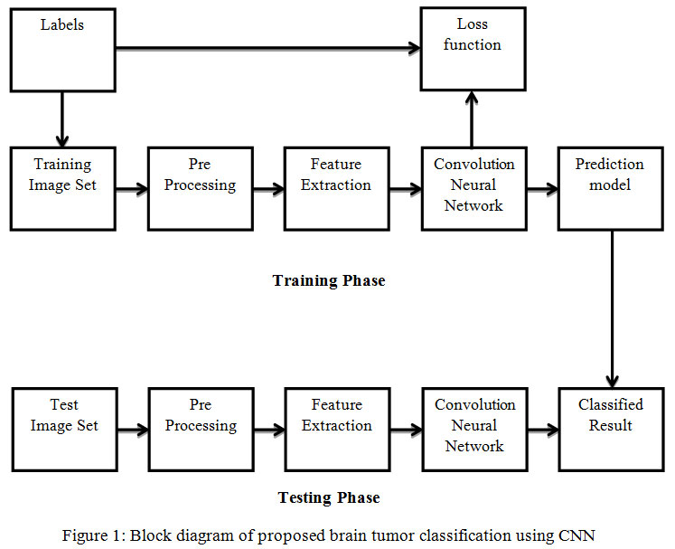
BLOCK DIAGRAM

Slide 12
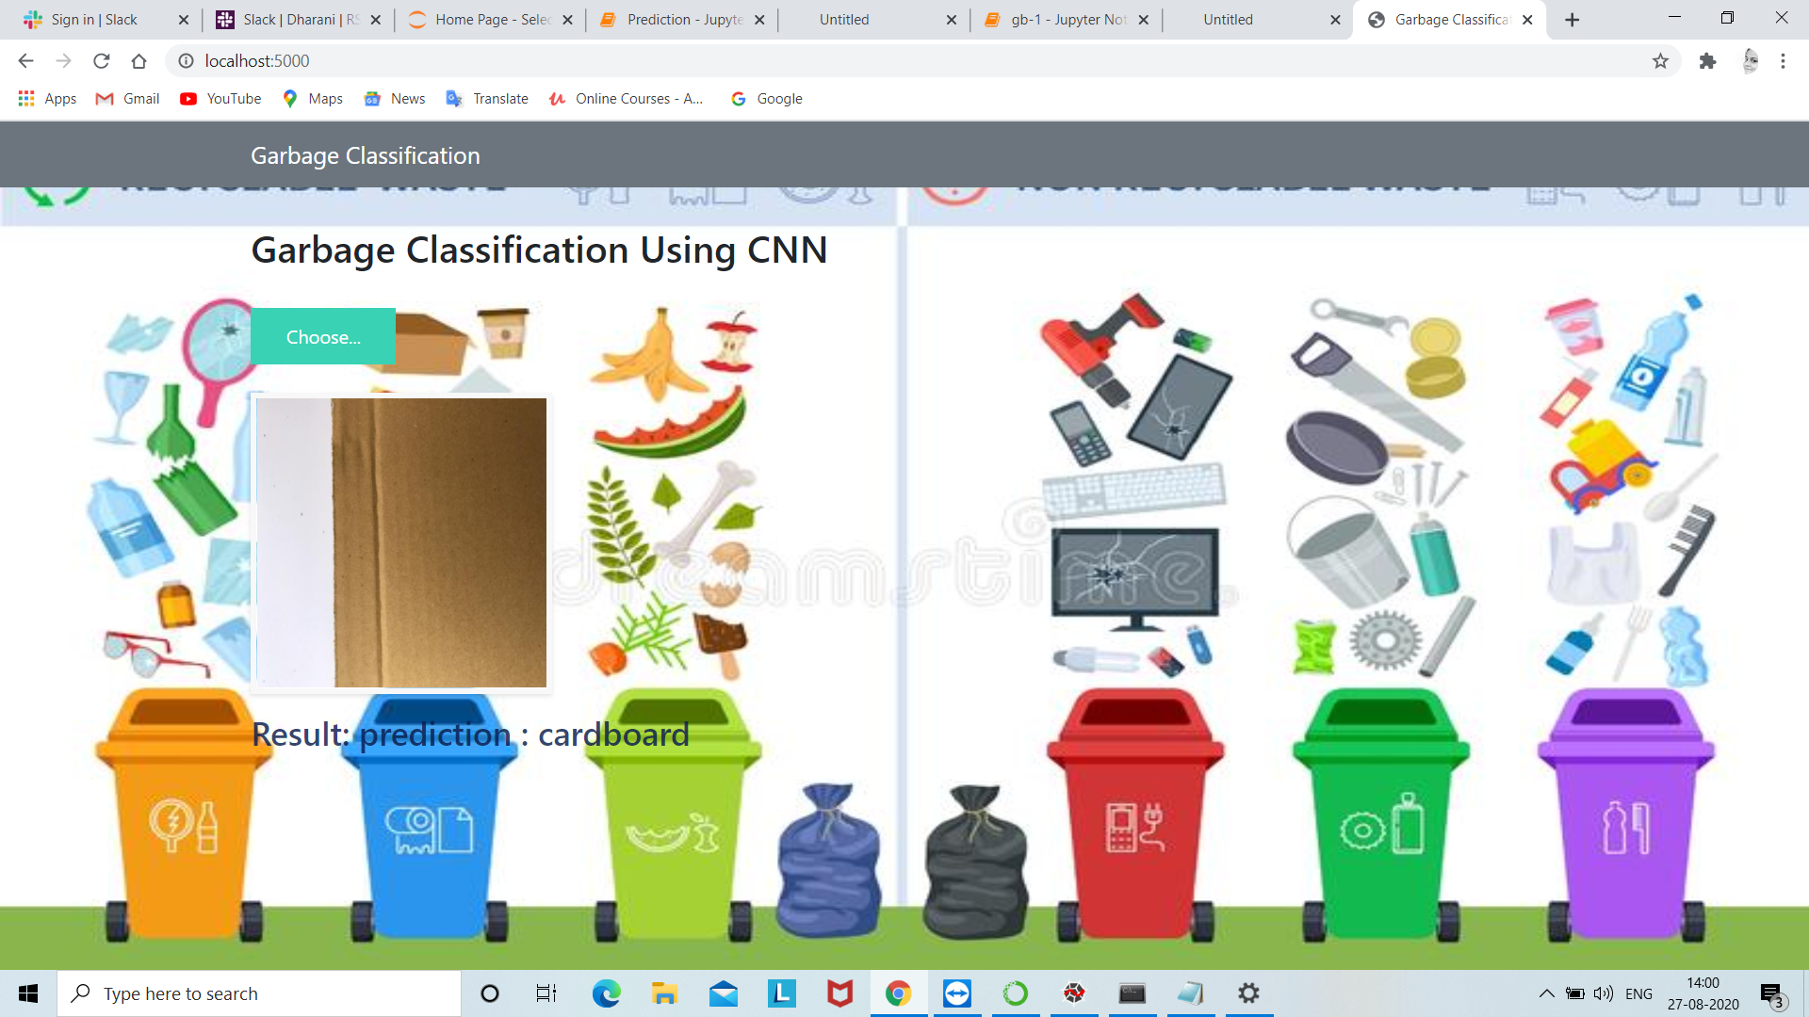
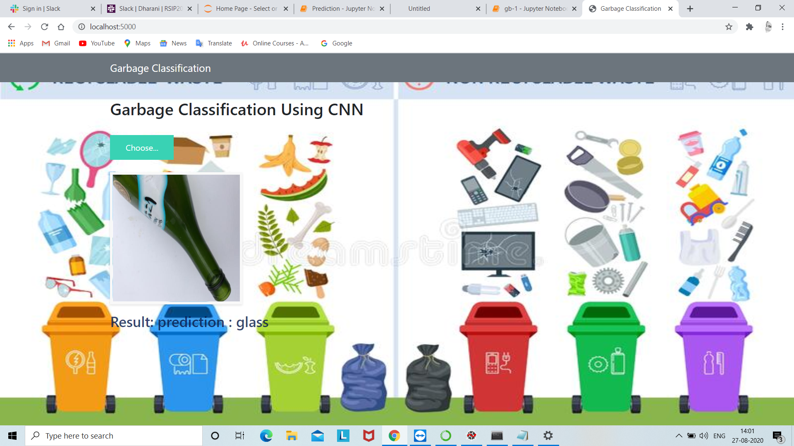
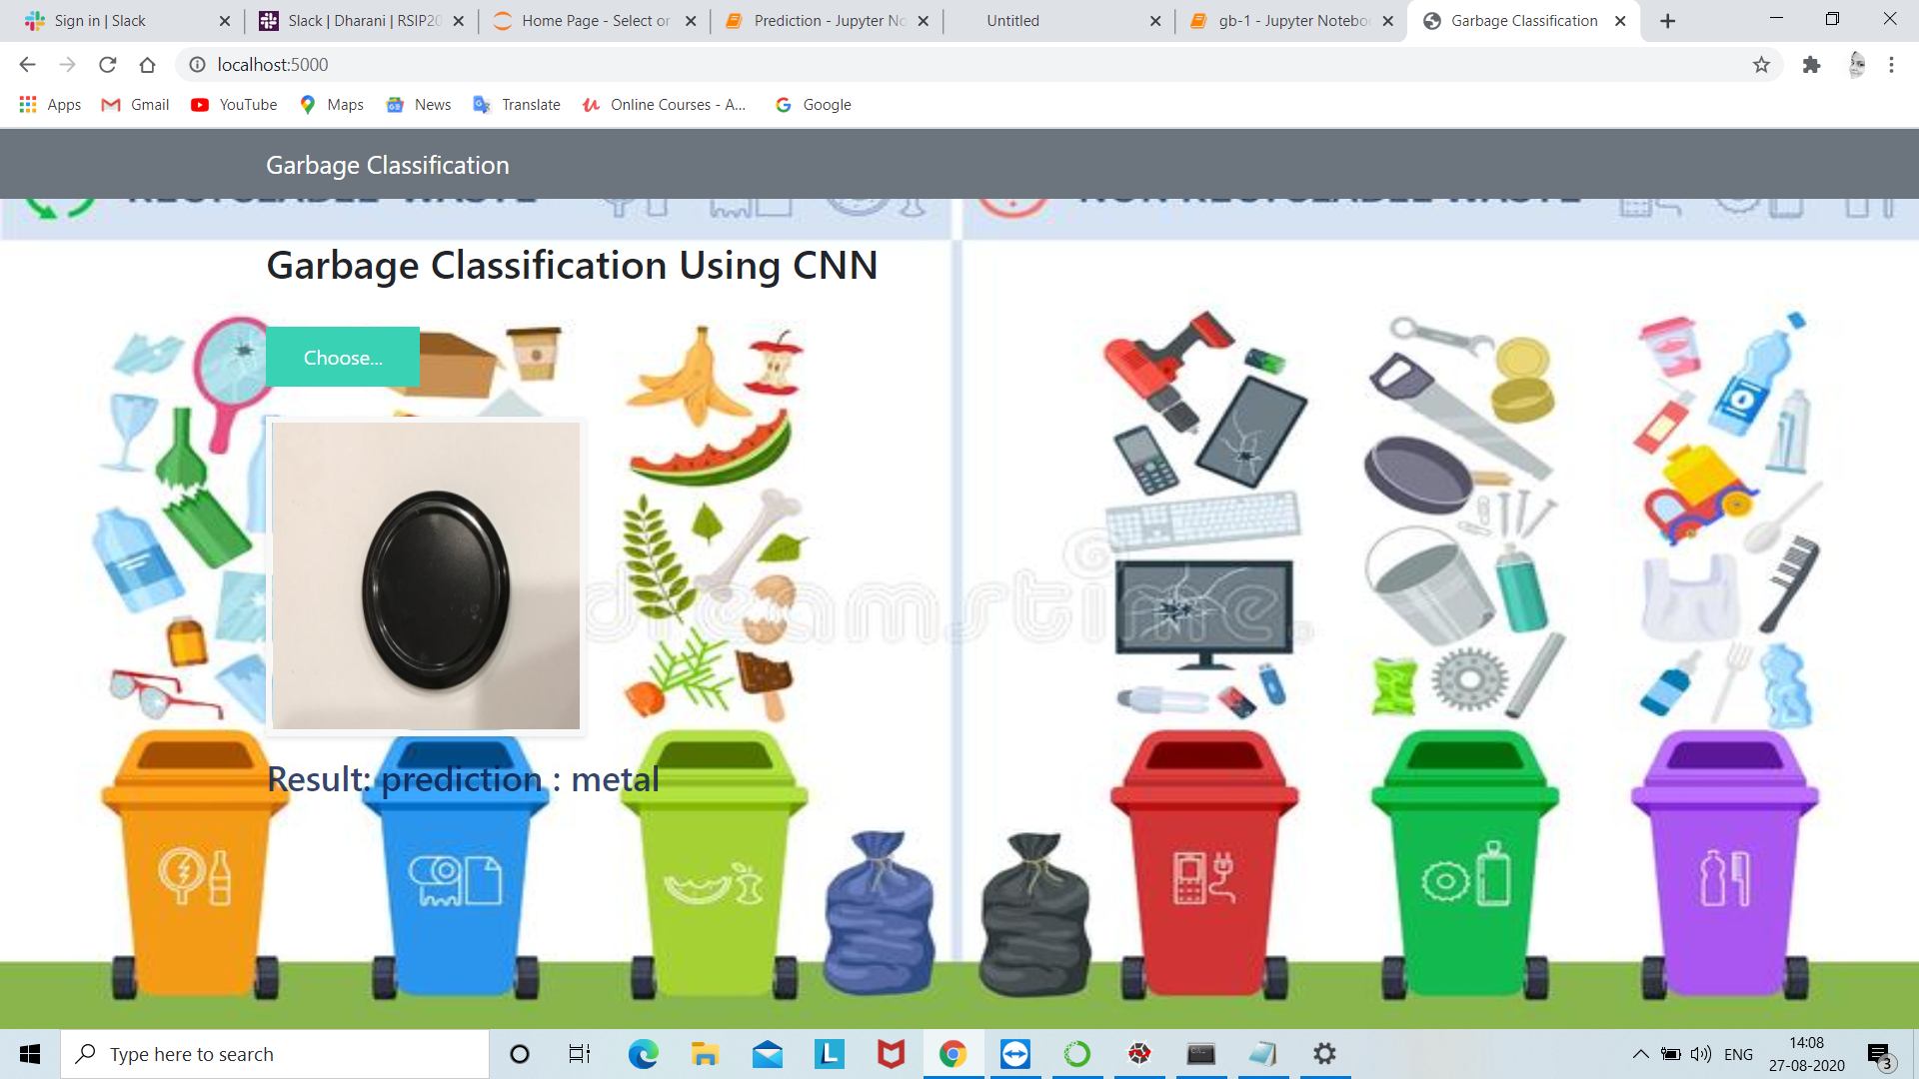
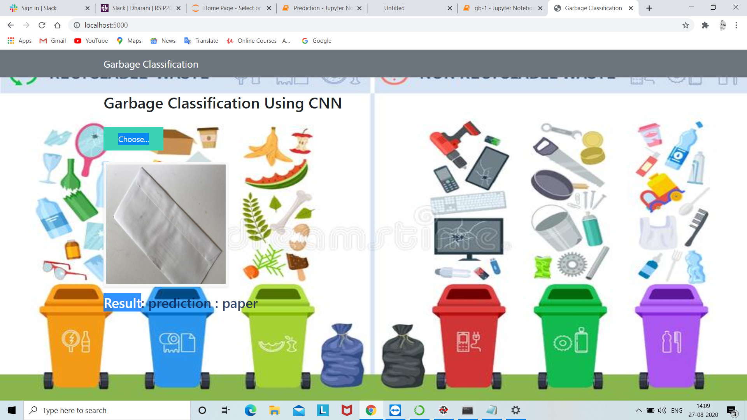
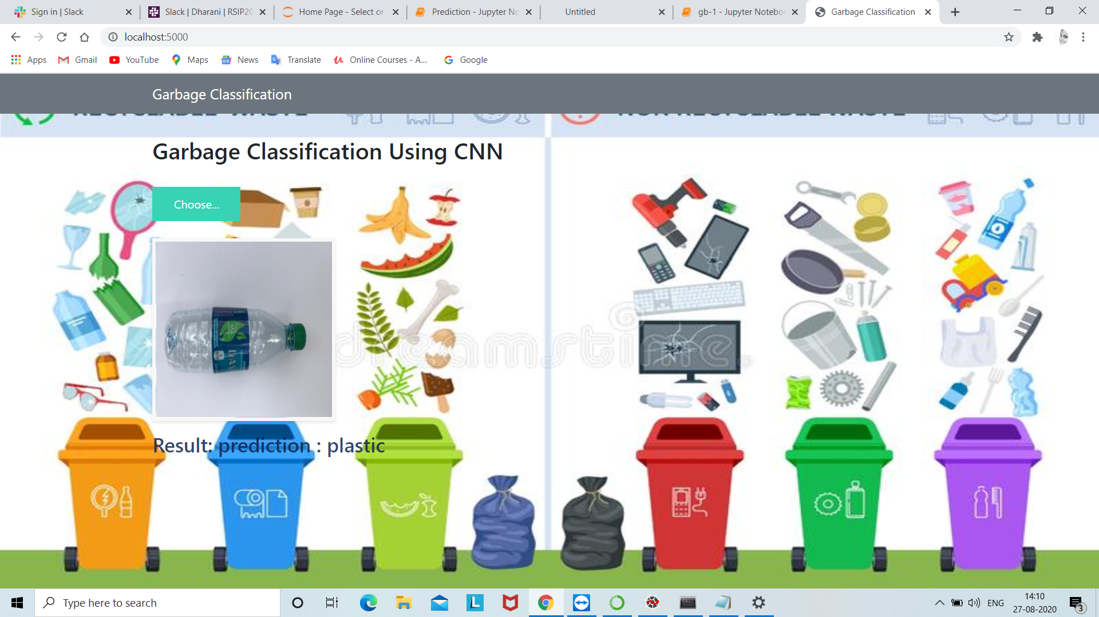
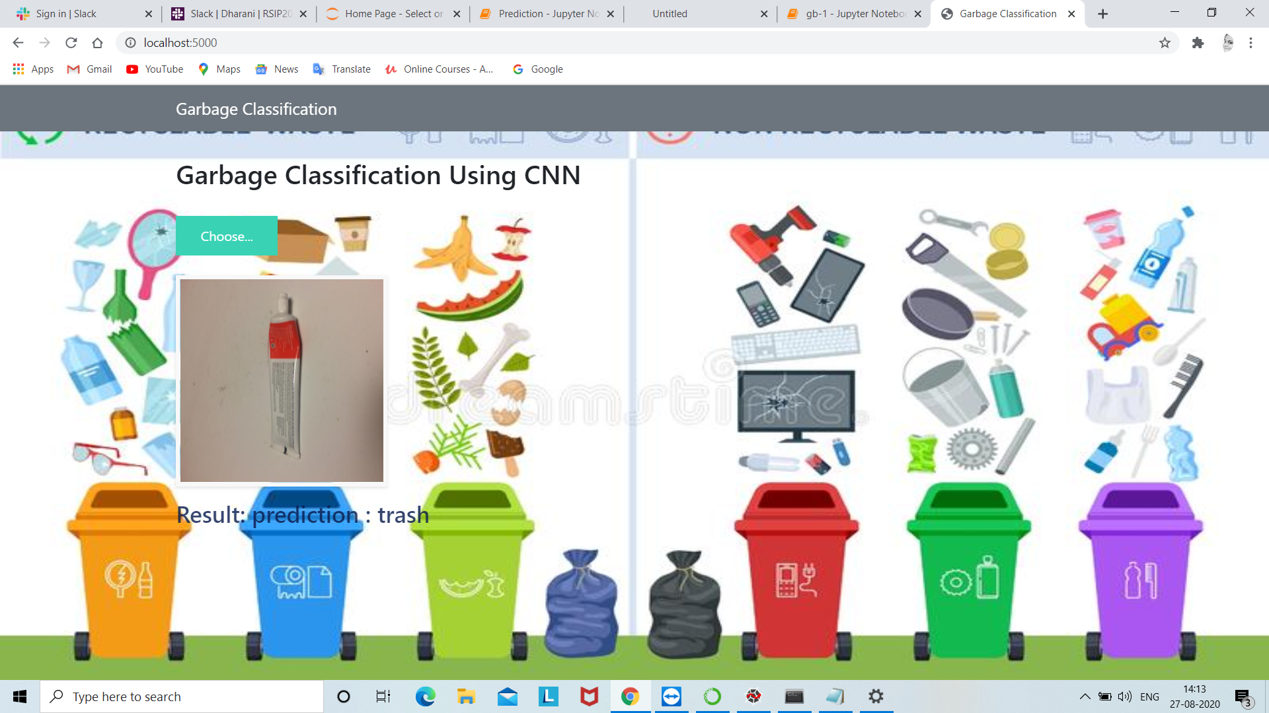
RESULT
This model detected where the given image is
Plastic
Glass
Paper
Cardboard
Trash

Slide 13
CONCLUSION
Making use of this prior computer technology, we have successfully found an algorithm to be trained to be identify the image and developed a process classify and sort trash into different categories such as metallic wastes, non magnetic metallic wastes, paper wastes and recyclable plastic wastes.
As future work ,a comparison with other classification algorithms will be performed in order to validate the current scheme or improve it.In addition , we consider changing the processor to another one with a higher computing capacity to be able to implement more complex computer vision algorithms.

Slide 14
THANK YOU

